Slide 1

Presentation Title
2
+
2
+
E LIBRARY ORDING FROM AMAZON

Slide 2
AIM:- TO ANALYSE E-LABRARY FROM AMAZON APPLICATION
2
+
NAME G DILEEP
REG NO 192011403

Slide 3
REQUIREMENTS:-
LOGIN
SELECT THE PRODUCT OR BOOK
ADD TO CORT
NUMBER OF PRODUCTS
FULL ADRESS
SELECT PAYMENT METHOD
PLACE THE ORDER

Slide 4

E-library ording application

Slide 5
The Order process
Select Proceed to Checkout after you have reviewed the items in your Shopping Cart.
If prompted, sign in to your account or create a new account if this is your first order.
Enter a shipping address.
Choose a shipping method.
Enter your payment information
Review your order details

Slide 6
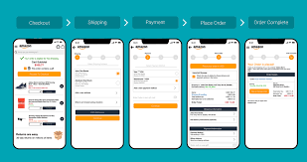
ORDERING PROCESS

Slide 7
Advantages and disadvantages online shoping
ADVANTAGES:-Customers can purchase items from the comfort of their own homes or workplace. Shopping is made easier and convenient for the customer through the internet. It is also easy to cancel transactions. Saves time and efforts
DISADVANTAGES:- fraud in online shopping is the biggest disadvantage of online shopping. Many people are attracted by great offers which seem too good to be true. Fake online shopping portals display some great products on their website and attract customers to buy the product.

Slide 8
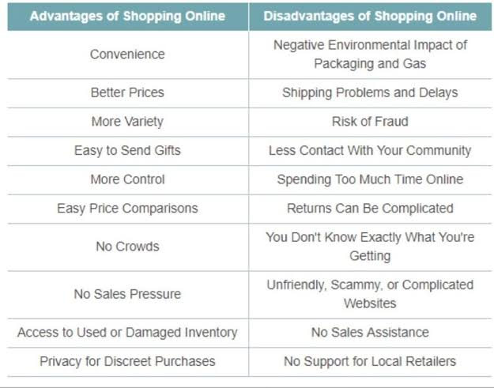
ADVANTAGES AND DISADVANTAGES B/W THEM

Slide 9
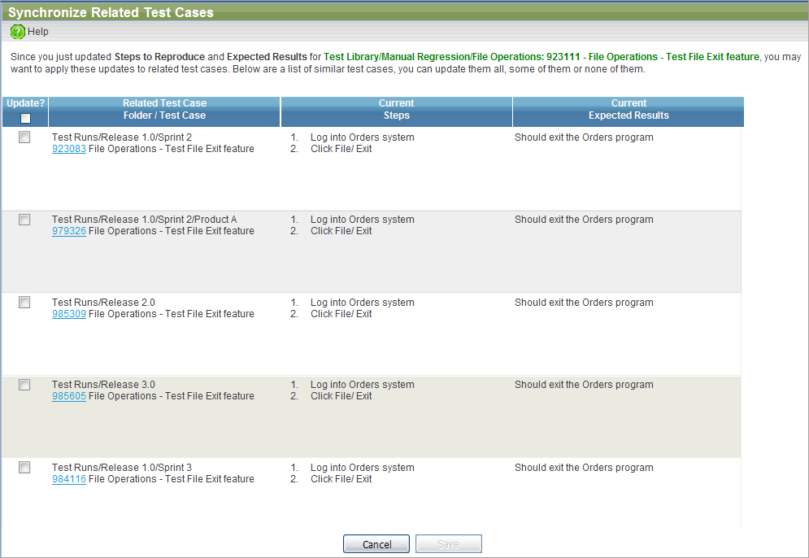
ONLINE LIBRARY TEST CASES

Slide 10
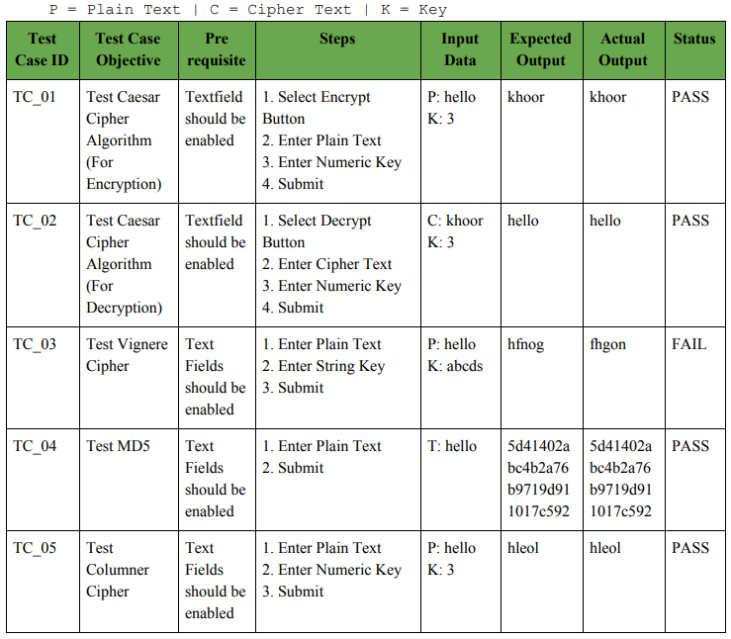
Positive and negative test cases

Slide 11

thanks

